Slide 1










How to write a scientific paper?
“IEEE Publication Recommender”
www.agrimetsoft.com
https://youtube.com/AgriMetSoft/

Slide 2



About IEEE Publisher
IEEE Publisher
Institute of Electrical
and Electronics Engineers
 The professional home for the engineering and technology community worldwide
Electrical engineering, computing, biotechnology, telecommunications, power and energy, etc.
2
Notes:
The professional home for the engineering and technology community worldwide

Slide 3






What are the IEEE Publication Types?
Journals
Magazines
Conference
Books
3

Slide 4
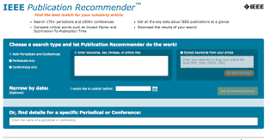

How Does IEEE Publication Recommender Work?
4

Slide 5




What are the other concepts?
Wiley
Watch
the next video
Taylor
Scopus

Slide 6





Please subscribe to our channel (https://youtube.com/AgriMetSoft/)
Like & do not forget to share it!!
Put your comments and questions below the video.
www.agrimetsoft.com
https://youtube.com/AgriMetSoft/
Notes:
Please hit the thumbs up button and don’t forget to subscribe !

